Slide 1
Night Light
Mission 12

Slide 2

Pre-Mission Preparation
In this mission you will use CodeX’s built-in light sensor.
What real-world projects can it be used for?

Slide 3

Mission 12: Night Light
You'll use the CodeX's built-in light sensor to
detect light and use the pixels as a night light!
You will create two versions of the night light.
Project Goals:
Use a simple on/off control
  Light (pixels) turn on when the sensor detects “dark”
Variable dimming
  Brighter light for a darker room

Slide 4

Objective #1: Let there be sensor
So you want to make a night light?
This is going to be easy with CodeX
It has its own built-in light sensor
Click on and read the first 2 paragraphs
Go to the Mission Log and answer the questions.
Then close the toolbox.

Slide 5
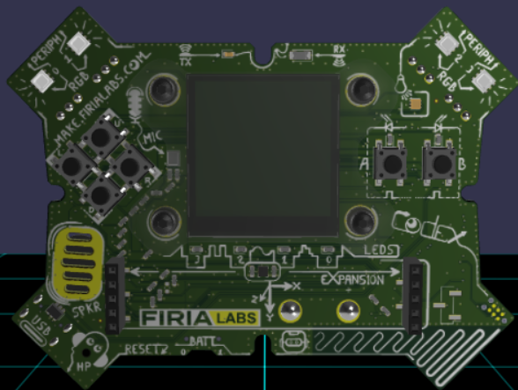
Mission Activity #1
DO THIS:
Close the instruction panel
Use the camera controls to rotate and zoom in
Click on the light sensor
Create a new file named NightLight

Slide 6
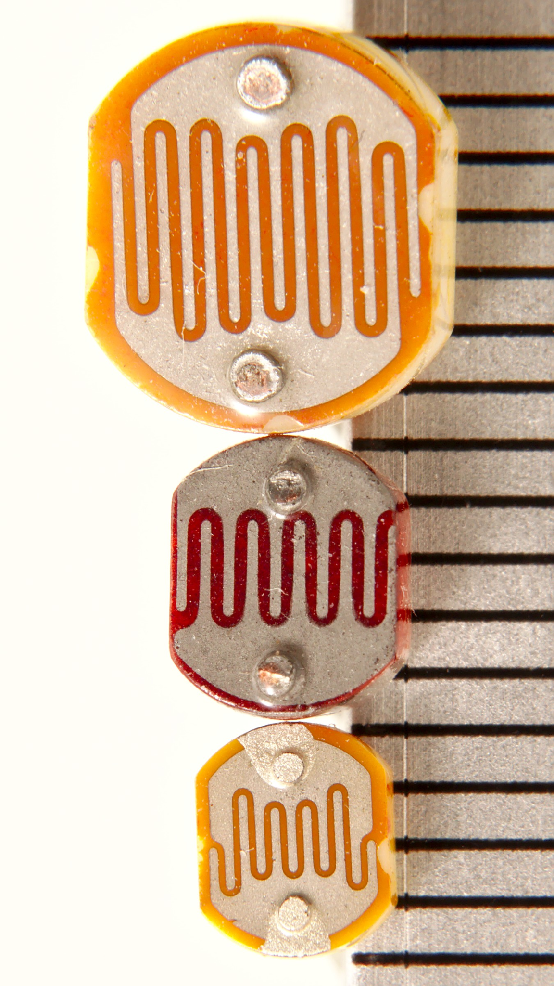
Objective #2: Light sensing code
The light sensor changes, or converts, light level into a digital value.
Dark = lower values
Light = higher values
Digital values go from 0 to 65,535
Any value below 2,000 is pretty dark!
To read from the light sensor, use:
  value = light.read()

Slide 7
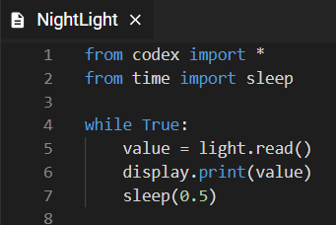
Mission Activity #2
DO THIS:
Import codex and time modules
Read the light sensor
Display the value
Change the light on the sensor by
trying three different types of light:
  Regular room light
  Shine a flashlight for bright light
  Cover the sensor with your hand for dark light
Write the value readings in the Mission Log

Slide 8

Objective #3: Pixel filler
Stadiums turn on all their lights when it gets dark.
You will turn on the four LED pixels when CodeX senses it is dark.
You can set all four LED pixels the same color quickly with this code:
pixels.fill(WHITE) -- turn on
pixels.fill(BLACK) -- turn off

Slide 9
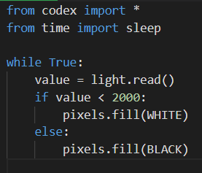
Mission Activity #3
DO THIS:
Add an if statement to your code
If the value from the sensor is dark (less than 2000) turn on the pixels
Else, turn off the pixels
Delete display.print() and sleep()
Test the code by covering and uncovering the sensor

Slide 10

Objective #4: Dimmable light sensor
Your night light is either fully on or completely off.
If it is a little dark, a little light will do.
Make the night light gradually brighter as the room gets darker.

Slide 11
Objective #4: Dimmable light sensor
Add information to the pixels.fill()
command to control the brightness
of the pixels.
brightness is a value from 0 to 100
Use the brightness level like this:
pixels.fill(WHITE, brightness = 20)

Slide 12
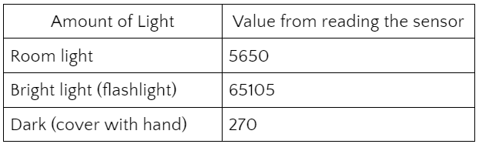
Mission Activity #4
DO THIS:
Look at your table from Objective #2
What value did you write down for room light?
Use a number a little less than that for your ROOM value.
For example, if my table looked like this:
I could use
ROOM = 5500
<continued>

Slide 13
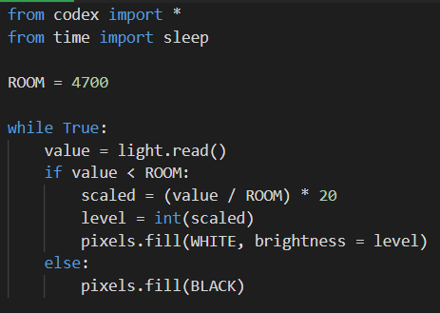
Mission Activity #4
DO THIS:
Define ROOM
Change the condition of the
if statement
Do a little math to calculate the brightness level
Test your code
WARNING - it may be a little glitchy

Slide 14

Light Test
During this mission you have learned about the light sensor.
Answer 2 quiz questions about the concepts.
CODEX
QUIZ

Slide 15
Objective #5: Reversed
When testing your code, you might notice that the pixels get darker as the room gets darker.
You want the opposite!
You will need to reverse the math.

Slide 16
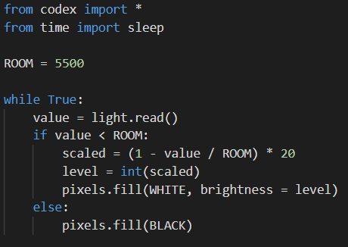
Mission Activity #5
DO THIS:
Change the math to reverse the value for brightness
Test your code

Slide 17
Post-Mission Reflection
Read the “completed mission” message and click to complete the mission
Complete the Mission 12 Log

Slide 18
Clearing your CodeX
Go to FILE -- BROWSE FILES
Select the “Clear” file and open it
Run the program to clear the CodeX

